Slide 1
My proposal of Automotive service platform
—based on aws cloud solution

Slide 2
My Name:
My Project contribution: 100%
Workload Distribution:
I design all the project and I finished all the coding works

Slide 3
How I plan to do it

Slide 4

User: End-users interact with the blog application through their web browser.
API Gateway: Handles incoming HTTP requests and routes them to the appropriate Lambda function.
AWS Lambda: Executes the blog application's code, which retrieves and processes blog data.
DynamoDB: Stores the blog data (e.g., title, text).
Amazon S3: Stores the blog images.
AWS CloudWatch: Monitors the performance of Lambda functions and API Gateway, collecting logs and metrics.
AWS X-Ray: Analyzes the performance of Lambda functions and API Gateway by tracing requests and providing insights into latency and errors.

Slide 5
How I design and architecture the structure of the aws solution

Slide 6
Select a suitable framework and language: I choose Flask/ python/aws ec2/ aws s3/AWS Lambda
Set up the website on Amazon Web Services (AWS): Create an account on AWS and set up the necessary resources, such as an Amazon Elastic Compute Cloud (EC2) instance, an Amazon Simple Storage Service (S3) bucket, and an Amazon RDS database.
Install and configure the My website: Install and set up the framework on the EC2 instance, and configure the necessary settings, such as the database connection.
Design and develop the website: Use a pre-built theme or create a custom design for the website, and develop the necessary pages, such as the homepage, blog, and contact page.
Test and launch the website: Test the website to ensure that it is functioning correctly, and then launch it on the domain name(https://ec2-35-78-249-90.ap-northeast-1.compute.amazonaws.com:80/home/1)

Slide 7
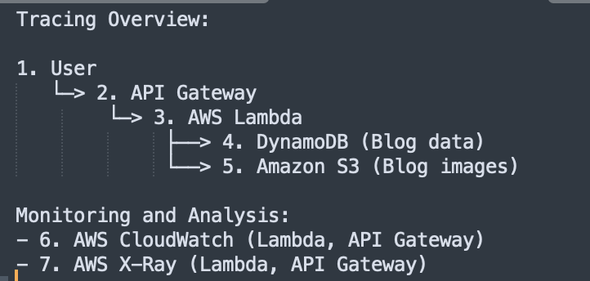

Slide 8
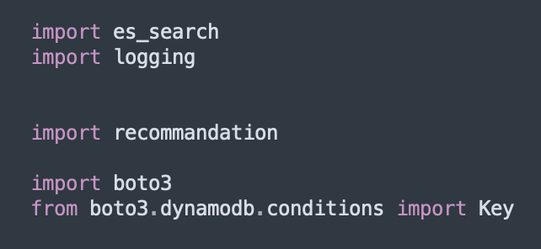
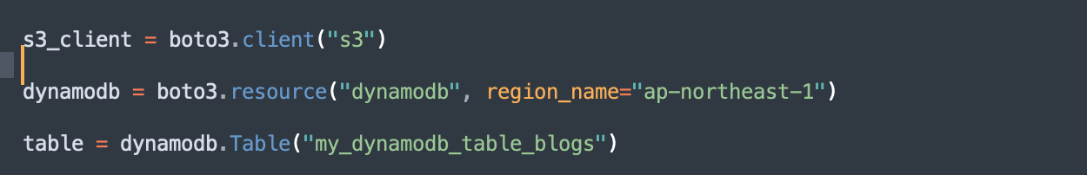
Import related library and init dynamodb and s3

Slide 9
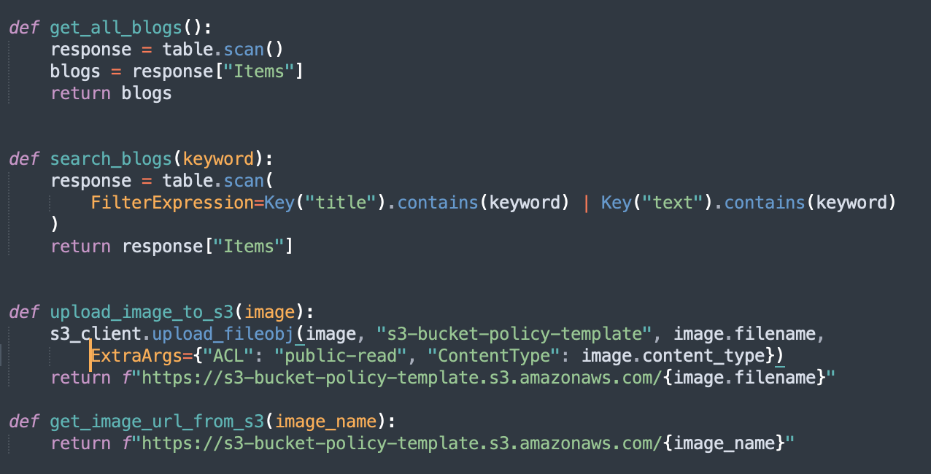
Invoke dynamodb and s3

Slide 10
One possible architectural solution for building Flask services on AWS would involve the following components:
Amazon Elastic Container Service (ECS): This service allows you to easily deploy, run, and scale containerized applications on AWS. You can use ECS to deploy your Flask services as Docker containers.
Amazon Elastic Container Registry (ECR): This service allows you to store and manage your Docker images in a private registry on AWS. You can use ECR to store your Flask service images and easily deploy them to ECS.
AWS CloudFormation: This service allows you to use a simple YAML or JSON file to model and provision, in an automated and secure manner, all the resources needed for your applications across all of your regions and accounts.
This is one example of an architectural solution for building Flask services on AWS, and there may be other options available depending on the specific requirements of your application.

Slide 11
Amazon Elastic Load Balancer (ELB): This service allows you to distribute incoming traffic across multiple targets, such as ECS tasks or EC2 instances. You can use ELB to balance traffic to your Flask services and ensure high availability.
Amazon RDS: This service allows you to easily set up, operate, and scale a relational database in the cloud. You can use RDS to store data for your Flask services, and connect to it using a database connector library such as Flask-SQLAlchemy.
Amazon S3: This service allows you to store and retrieve any amount of data, at any time, from anywhere on the web. You can use S3 to store and retrieve files and images used by your Flask services.
AWS Identity and Access Management (IAM): This service allows you to manage access to AWS resources. You can use IAM to set up fine-grained access controls for your Flask services and their associated resources, such as ECR images, RDS databases and S3 buckets.
Amazon CloudWatch: This service allows you to monitor AWS resources and the applications you run on AWS. You can use CloudWatch to monitor your Flask services, and set up alarms and notifications for specific metrics such as high error rates.

Slide 12
Monitoring and Analyzing Automotive service
Application Performance with AWS CloudWatch and X-Ray
/home route latency: Average response time across all requests.
Request count: Total number of requests to the /home route.
Error count: Total number of errors encountered during requests.
Alarms:
Latency Alarm: Triggered when the average latency of the /home route exceeds 2 seconds over a 5-minute period.
Error Rate Alarm: Triggered when the error rate (errors/request) exceeds 1% over a 5-minute period.
Execution Results (Sample Data):
Latency: 1.5 seconds (average)
Request count: 10,000 requests (in 1 hour)
Error count: 50 errors (in 1 hour)
No alarms triggered during the test period.

Slide 13
Monitoring and Analyzing Automotive service
Application Performance with AWS CloudWatch and X-Ray
Request tracing enabled for the /home route using AWS X-Ray.
Service Map: Visual representation of the components and dependencies of the /home route.
Analysis Points:
Latency breakdown across different components (e.g., Lambda, DynamoDB, S3).
Error and exception analysis with insights into root causes.
Execution Results (Sample Data):
Lambda: 800 ms (average)
DynamoDB: 400 ms (average)
S3: 300 ms (average)
No significant issues or bottlenecks identified.
The sample data provided in the execution results is for illustrative purposes only.
The actual results may vary depending on the application's code and infrastructure, as well as the test conditions.
This presentation demonstrates how to use AWS CloudWatch and X-Ray services to monitor and analyze the performance of the blog application,
with a focus on the /home route.

